Slide 1
Pool Overview

Slide 2
Project can be found here:
http://bear.cira.colostate.edu/rammb_tc_group/pool
git@bear.cira.colostate.edu:rammb_tc_group/pool.git

Slide 3
What is the pool?
Python software for selecting polar orbiting satellite data in a variety of formats (ATMS, AMSU, NUCAPS, VIIRS, Radiosondes, etc.)
Primary use case is for selecting satellite data around a tropical cyclone center
Can function as command line application and API

Slide 4
How does it work?
Open each file once and store time/space info in a database
Query database with simple time/space criteria, get a list of files matching criteria
Can optionally deliver HDF5 file of samples from original data that lie within search criteria

Slide 5
Grid Database
Every sample from a file has its location checked inside a 3D grid
Grid axis are lon, lat, time
Grid cells just contain a list of files that intersect the cell
When a sample intersects a grid cell, the file it belongs to is added to the cell
Grid is “sparse”
Grid cells don’t exist until a file intersects it

Slide 6
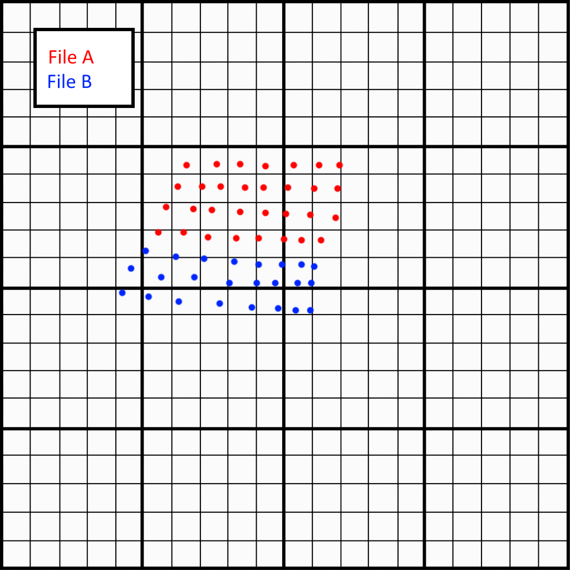

Slide 7
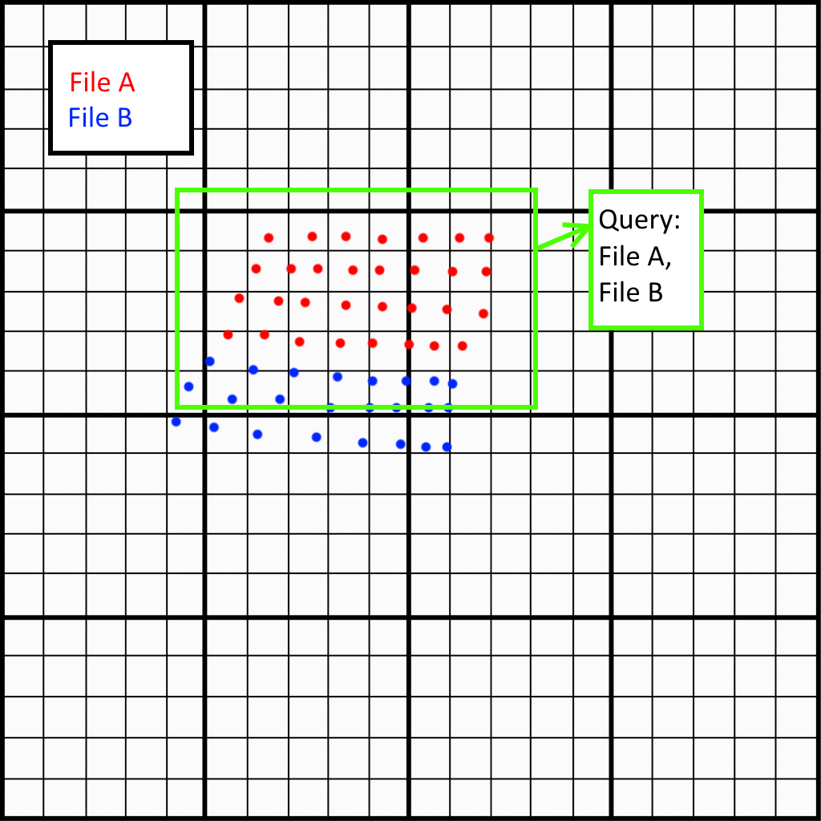

Slide 8
Performance
1 year of global NUCAPS data can be added to a database using about 2.5 days of processing time
If data is at a higher resolution than your grid, performance can be improved by skipping a large fraction of the points in each file
Getting a list of files from a query takes a fraction of a second

Slide 9
Commands
Functionality divided into three console commands/api calls
Create – Creates a database at a specified location
Update – Adds new file space/time info to the database
Query – Query the database with space/time search criteria, get a list of files matching search criteria

Slide 10
Using the pool
Command Line:
pool create config1.cfg config2.cfg … configN.cfg
pool update config1.cfg config2.cfg … configN.cfg
pool query config1.cfg config2.cfg … configN.cfg
API:
pool.create(config)
pool.update(config)
query_results = pool.query(config)

Slide 11
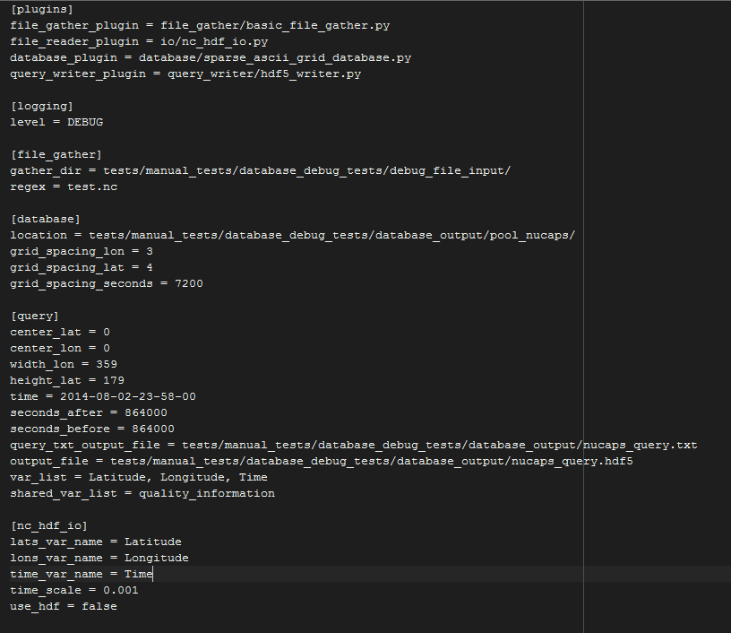
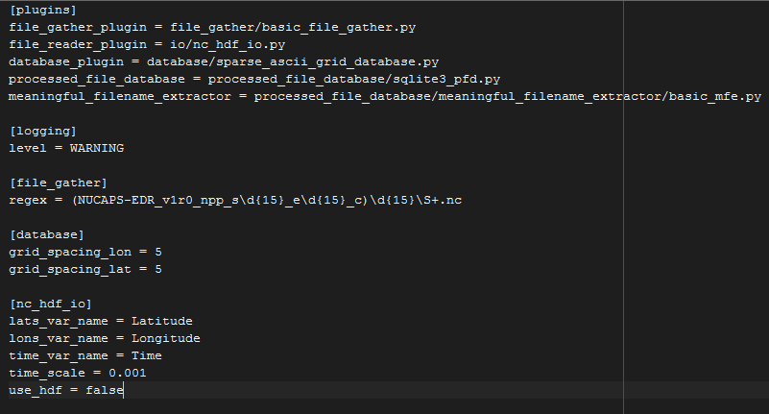
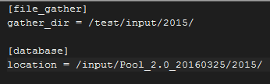
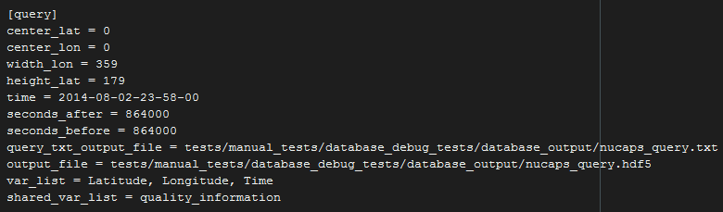
Controlled via ini files
All in one config
Split among several config files
shared_optons.cfg:
poolA.cfg:
query.cfg:

Slide 12
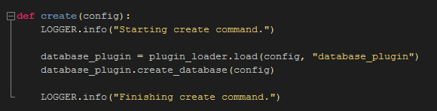
Plugins
Command code written at a high level of abstraction
Plugins loaded at runtime implement details of algorithm

Slide 13
Plugins
Basically just python modules loaded at runtime, expected to implement certain functions
9 different categories of plugins, 12 plugin implementations so far

Slide 14
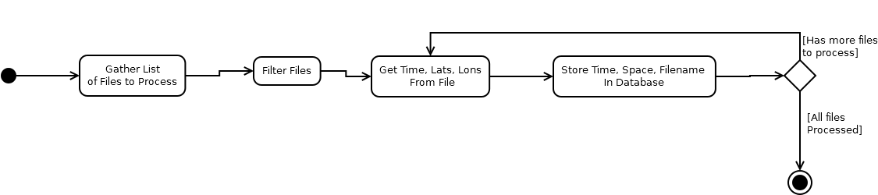
Update command plugins

